Slide 1

WHOA THERE!
DELETE THIS SLIDE BEFORE PRESENTING
Copy these slides to your Google Drive Account or Download as a Powerpoint File.
Customize the Wifi info and Introduction slides for your event.
Rehearse this presentation at least 1 - 2 times before the workshop.

Slide 2

v.0.0.2
Notes:
v0.0.1
Initial release of the workshop (Hello World!)
v0.0.2
Fix some minor typos in the notes / slides
Add slide for Amazon promotions

Slide 3


Welcome to
MLH Localhost: Hacking with Alexa!
Wifi Network:
[Network]
Wifi Password:
[Password]
Event Hashtag:
#MLHLocalhost
Twitter Handle:
@MLHacks
Notes:
What to Edit:
Update this slide to include the wifi information.
What to Say:
Explain how to connect to the wifi.
Encourage participants to Post Photos on Facebook, Twitter or Instagram using #MLHLocalhost
What to Do:
Check that everyone is connected by asking the group to give you a signal if they are connected.

Slide 4

Welcome! My name is
[INSERT YOUR NAME].
[Put your Photo Here]
1
I’m here to lead this session & help you learn something new today!
2
I’m a [LEVEL OF STUDY] at [SCHOOL].
3
My favorite programming language / tool is [LANGUAGE OR TOOL].
Notes:
What to Edit:
Add your name, photo, school info, and favorite programming tool or language.
What to Do:
Make attendees feel welcome by running a short Ice Breaker.
Go around the room and ask each person to answer the following questions:
Who are you?
What year are you in school and what is your major/field of study?
What is your favorite programming language or tool?
You should go first to demonstrate the exercise and introduce yourself

Slide 5
Using your Web Browser,
Open this URL & Fill out the Form:
Afterwards, Check your Email to Find:
1
http://mlhlocal.host/checkin
2
Setup Instructions
An Invite to the MLH Slack
The Code Samples
A Workshop FAQ
These Workshop Slides
More Learning Resources
Notes:
What to Say:
Tell attendees we are going to check them in for the event
Once attendees checkin, they will receive an email with the items listed on the slide
Attendees must checkin to get credit for attending this event
What to Do:
Confirm that everyone has checked in by asking participants to give you a signal when they receive the email.

Slide 6

Our Mission is to Empower Hackers.
65,000+
HACKERS
12,000+
PROJECTS CREATED
3,000+
SCHOOLS
We hope you learn something awesome today!
Find more resources: http://mlh.io/
Notes:
What to Say:
Major League Hacking (MLH) events are meant to bring hackers together so they can learn, build, and share.
Give participants a brief overview of Major League Hacking (MLH).
Tell participants they can learn more at http://mlh.io/
Example Talking Points:
Through Localhost MLH is rethinking technology education to reflect how hackers actually learn and how fast the industry moves.
Here’s some quick facts about MLH:
Each year, MLH supports over 65,000 hackers around the world at events they facilitate
Those students create more than 12,000 amazing projects together
MLH is a global organization that empowers hackers at more than 3,000 schools and growing every day

Slide 7
What will you learn today?
1
Understand Voice User Interfaces & what you can build using them.
2
Meet Alexa, an intelligent personal assistant developed by Amazon.
3
Create your first voice powered app with Amazon Alexa.
Notes:
What to Say:
Explain to participants what they will learn today
Learning is a core part of being a hacker and today they are going to learn something new
What to Do:
Get participants excited about the experience.

Slide 8
Notes:
What to Say:
Explain that we’re going to give everyone an overview of voice user interfaces and demo the Alexa voice assistant.
What to Do:
This quick poll will give you an idea of how familiar your audience is with voice UIs and Alexa.
Ask participants to raise their hand if they have used Alexa or Google Home or Siri before.
Ask participants to keep their hands up if they have an Amazon Echo device.

Slide 9
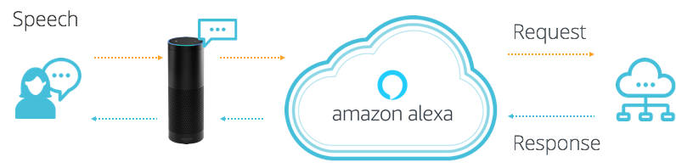
What is Alexa?
Alexa is a Voice User Interface (VUI), that lets you speak commands, instead of clicking buttons or typing on your keyboard.
Alexa listens to spoken input, uses it to execute tasks or skills in the cloud, and then returns output -- just like a JavaScript function.
Notes:
What to Say:
Voice User Interfaces (VUIs) enable you to speak commands rather than typing them on a keyboard or swiping a touchscreen.
Alexa is Amazon's voice service that listens to spoken input, uses it to execute computing tasks, and then returns output
What to Do:
Demonstrate Alexa by asking questions in front of the audience. If you have a physical device, use that. Otherwise, you can use the browser simulator (https://www.echosim.io/)
“Alexa, what is the weather?”
“Alexa, tell me a joke.”

Slide 10


Why do Voice UIs Matter?
Instead of typing, clicking, or tapping - we can physically separate ourselves from our devices and speak commands naturally.
Voice UIs can run code in the cloud and communicate with IoT devices, making them ideal for homes, cars, & more.
Notes:
What to Say:
VUIs signify a big shift in how we interact with technology
We can physically separate ourselves from devices and speak naturally
When our hands are busy, we can interact with our devices and apps without looking up
What to Do:
Ask the audience, “where might voice user interfaces be useful?”. Pick people who raise their hand. Here are some common answers:
While driving the car
When running or exercising
While cooking a meal

Slide 11

What can you build with Alexa?
Alexa, ask Lyft for a Lyft Line to work.
Notes:
What to Say:
Alexa is programmable, so you can connect it to webapps and other APIs
You could build smart remotes for your TV, a skill to hail a cab, order a pizza, etc.
The next few slides contain some examples.
Lyft - you can ask Alexa to call a lyft cab to your location.

Slide 12


What can you build with Alexa?
Alexa, ask Capital One, what did I spend?
Notes:
What to Say:
Capital One - Check on your bank account and spending habits.

Slide 13
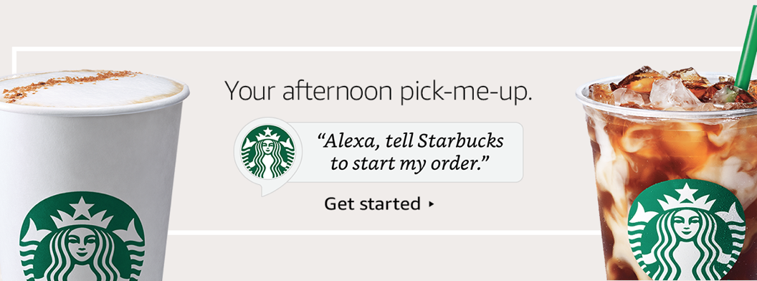
What can you build with Alexa?
Alexa, tell Starbucks start my order.
Notes:
What to Say:
Starbucks - order your coffee ahead of time when you’re walking out the door.

Slide 14
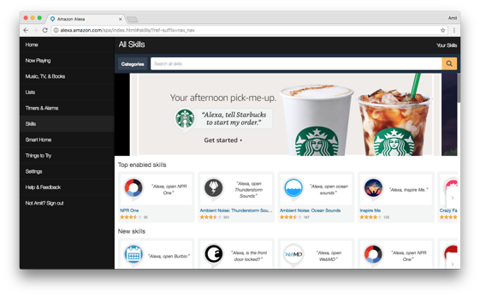
Alexa has Skills. Lots of them.
Companion app for device setup, skills, remote control, and more.
alexa.amazon.com
Notes:
What to Say:
Alexa has tons of skills you can use today
You can also search and discover skills by visiting amazon.com/skills
Today you are going to learn how to make one.
What to Do:
Ask participants if they have used any other Alexa apps or skills. Here are some other popular ones if you need examples:
NPR - Listen to Podcasts
Seamless - Order delivery to your house
Jeopardy - Play Jeopardy with Alexa.

Slide 15
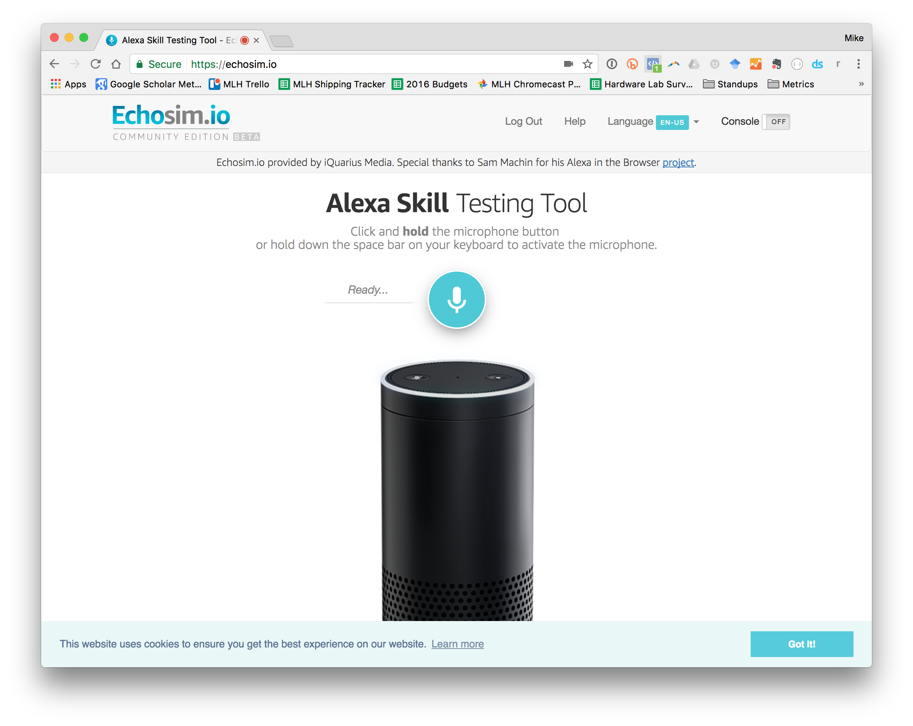


It’s LIVE Demo Time!
Try these commands:
“Alexa, tell me a joke!”
“Alexa, what is
Major League Hacking?”
Don’t have an Alexa device?
Head to: echosim.io
Notes:
What to Say:
Time for participants to try out Alexa.
What to Do:
Let participants play with Alexa for about 5 minutes:
(If you have a physical device) Invite a few participants to come up and play with the Alexa.
(If you don’t have a device) Tell participants to head to echosim.io, login with their amazon account, and try a few commands

Slide 16
Notes:
What to Say:
To build your first Alexa Skill, you’re going to need to know a few things which we will explain next.
What to Do:
Make sure everyone is paying attention again. They’ve been playing with Alexa, so they are probably pretty jazzed up.

Slide 17
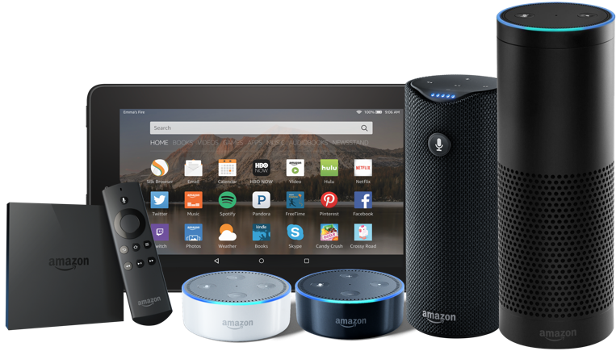
Why build an Alexa Skill?
Alexa, Amazon's voice service, is already integrated into Echo devices and can perform hundreds of skills.
Your skill can reach millions of customers with Alexa enabled devices.
Building with Alexa is free, easy, & fun!
Notes:
What to Say:
Why should you build an Alexa skill?
Alexa is already integrated into many devices include the Echo.
Amazon has millions of customers who could use your Alexa Skill
Building on Alexa is fun, easy, and free.

Slide 18


Alexa Skills are made of 2 parts:
Front End - The Alexa Voice UI handles text to speech, converting the audio into something our app can use, etc.
Back End - The logic code that actually powers our app. Usually this is written on a service called AWS Lambda.
AWS Lambda
Notes:
What to Say:
Each Alexa skill is made of two parts
Front End is the Alexa Voice User Interface. This takes user speech and converts it into something the computer can understand
Back End is where your application logic lives. This takes the parsed speech and does something interesting with it.
FAQ:
What is AWS Lambda?
You can think of Lambda as an event-driven computing platform; Lambda runs when triggered by an event and executes code that’s been loaded into the system. You don’t need to setup or manage any servers, just write the code and Amazon takes care of the rest.

Slide 19

Speech Recognition is Hard.
You said: fȯr tē tīmz. But, what did you mean?
Forty Times?
For Tea Times?
For Tee Times?
Four Tee Times?
Notes:
What to Say:
Understanding human speech is a hard problem for computers
There are two parts to understanding speech:
Speech Recognition - converting the audio to text
Natural Language Understanding - what is the context of this text?
Amazon has collected the top speech technology for you with Alexa, you don’t need to be an expert
What to Do:
Walk attendees through the example on the slides.
Imagine someone says “For Tea Times”
That could mean any one of these four things and Alexa can help you understand that

Slide 20
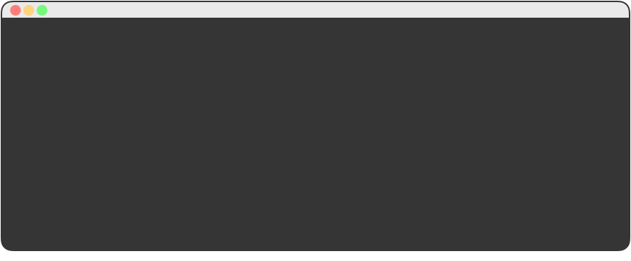
Alexa uses Sample Utterances
for Training.
In order to map user input to a behavior, we provide training data, for each intent.
01 GetNewFactIntent a fact
02 GetNewFactIntent a Major League Hacking fact
03 GetNewFactIntent tell me a fact
04 GetNewFactIntent tell me a Major League Hacking fact
05 GetNewFactIntent give me a fact
06 GetNewFactIntent give me a Major League Hacking fact
07 GetNewFactIntent tell me trivia
08 GetNewFactIntent tell me a Major League Hacking trivia
09 GetNewFactIntent give me trivia
10 GetNewFactIntent give me a Major League Hacking trivia
11 GetNewFactIntent give me some information
12 GetNewFactIntent give me some Major League Hacking information
13 GetNewFactIntent tell me something
14 GetNewFactIntent give me something
Notes:
What to Say:
In order to map user input to something, we provide Alexa training data
This slide shows some example training data which takes the format:
[Skill] [Sample Speech to Trigger This Skill]
The sample skill is called “GetNewFactIntent” and “give me a fact” is an example thing someone might say to trigger it
Your list doesn’t need to be exhaustive (every possible combination), Alexa will use this data to train herself and learn new phrases

Slide 21
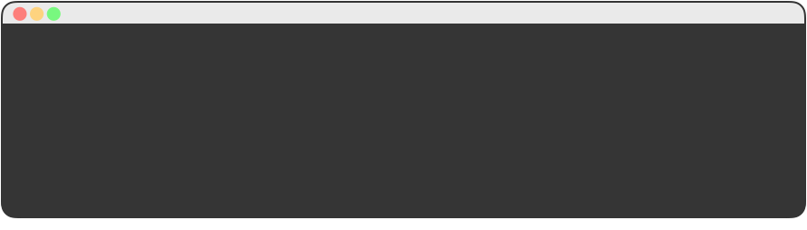
Alexa Maps Speech Input to Intents.
Once Alexa figures out what Intent you wanted, you can easily map that back to code.
01 {
02 "intents": [
03 { "intent": "GetNewFactIntent" },
04 { "intent": "AMAZON.HelpIntent" },
05 { "intent": "AMAZON.StopIntent" },
06 { "intent": "AMAZON.CancelIntent" }
07 ]
08 }
“Tell me a Fact about MLH” GetNewFactIntent
Notes:
What to Say:
An Alexa Skill (App) can have multiple commands.
We call those commands “Intents”
For example, an app that plays music may have a “Play” intent to start the music and a “Pause” intent to temporarily stop the music.
We tell Alexa what our intents are in a configuration file like this one.

Slide 22
Notes:
What to Say:
You are going to be building a skill that responds with facts about YOU!
You'll learn how to create a Voice UI, how Alexa processes commands, how to deploy code to AWS Lambda

Slide 23
Demo: About MLH Skill
Ask your Alexa:
“Alexa, open MLH Facts.”
“Alexa, ask MLH Facts for a fact.”
Don’t have an Alexa device?
Head to: echosim.io
Notes:
Setup:
Make sure you have the MLH Facts skill enabled. You can do this from the Alexa App on your phone.
What to Say:
We’re going to demo a skill that MLH made which returns facts about MLH
When you make your skill, it will return facts about YOU!
What to Do:
Demonstrate the MLH Alexa Skill by asking Alexa the following:
“Alexa, open MLH Facts.”
“Alexa, ask MLH Facts for a fact.”
If you have a physical device, use that. Otherwise use the Echo Simulator. (http://echosim.io/)

Slide 24
Steps to Build Your Skill:
To build your first skill, we’ll complete the following steps:
Write your skill code as an AWS Lambda function
Create an Alexa Skill in the Developer Portal
Connect Your Lambda Function to Your Skill
Test your Skill
Publish Your Skill
Notes:
What to Say:
These are the 5 steps to create an Alexa skill
In the first three steps, you will setup the main components and connect them together
At the end of this workshop, we’ll be testing out the skills you make
When you go home the next step is to publish your skill!

Slide 25
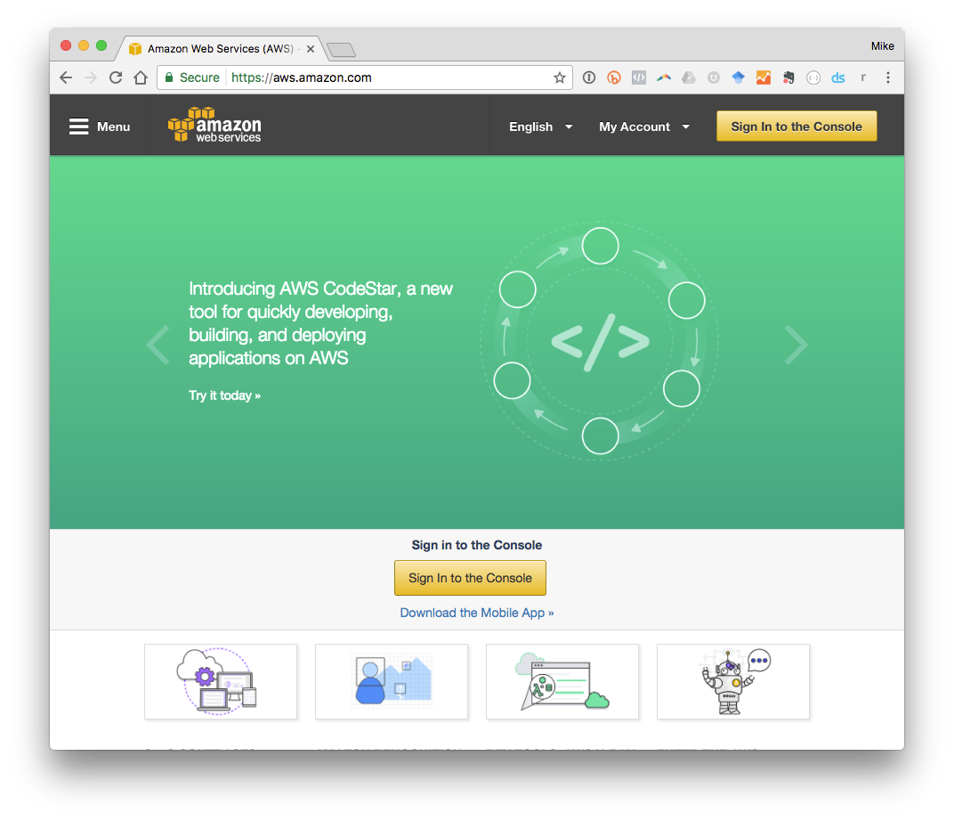
Sign into the AWS Console
Head over to:
mlhlocal.host/alexa-aws
Click on
“Sign in to Console” to create your first Lambda Function.
Notes:
What to Say:
We’re going to create an AWS Lambda function to power our skill
We can do that from the AWS Console, so let’s go there now.
Once you’re on the landing page for the AWS Console, click sign in and either create an account or login if you have one
What to Do:
Have participants open the URL in their browser and log in to the AWS console
Participants may need to sign up for an AWS account during this step
Walk around and help people get to the AWS Console dashboard

Slide 26
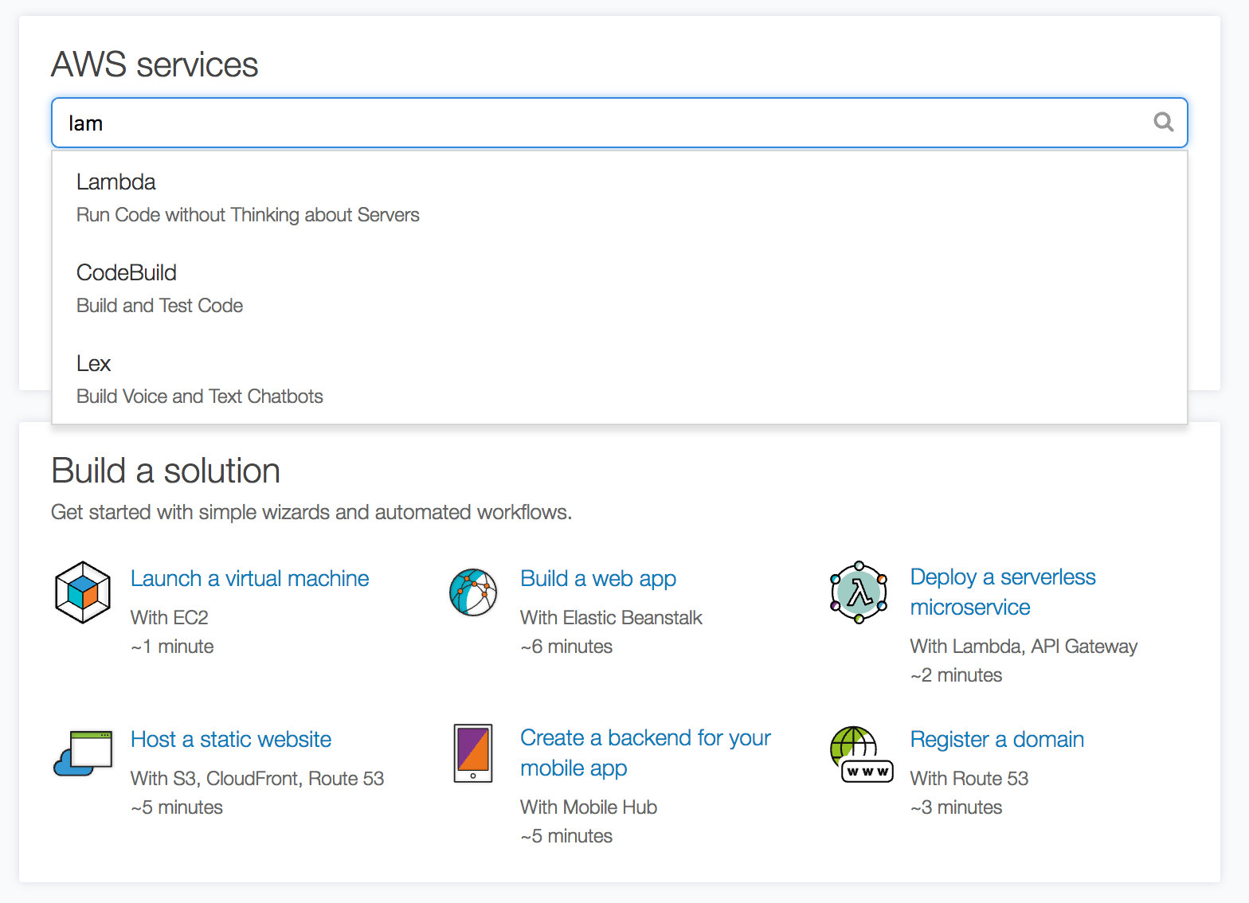
Navigate to the Lambda Manager.
You can search for Lambda in the search box or find it on the list of available services.
Notes:
What to Say:
The AWS Console is a portal to the many services AWS offers
We’re going to find the one that says “Lambda”.
You may need to click “Get Started” if you don’t see a screen like this one.
What to Do:
Have participants confirm they are using the “Northern Virginia” region.
They can see this in the top right corner, next to their name.
It should say “N. Virginia”
If it doesn’t, they can select “US East (N. Virginia)” from the region dropdown
Walk around and help participants find AWS Lambda on the console. Have them click the link to go to the dashboard.

Slide 27
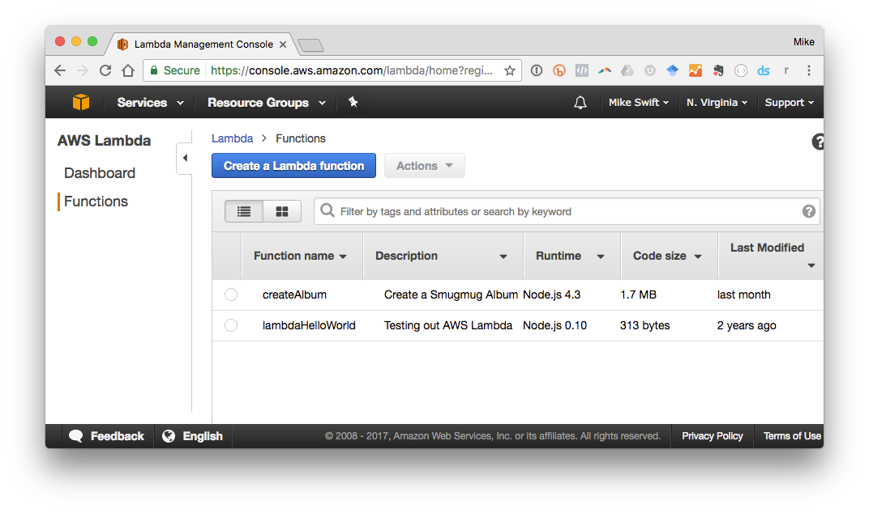
Create your First Lambda Function
Each AWS Lambda Function is responsible for one thing (like returning facts about you!).
Click on “Create a Lambda Function” to create your first function!
Notes:
What to Say:
Each AWS Lambda Function is responsible for one thing.
In this case we are going to create a function that returns a fact about you.
What to Do:
Ask participants to click on “Create a Lambda Function”
Walk around and make sure they are finding everything OK

Slide 28
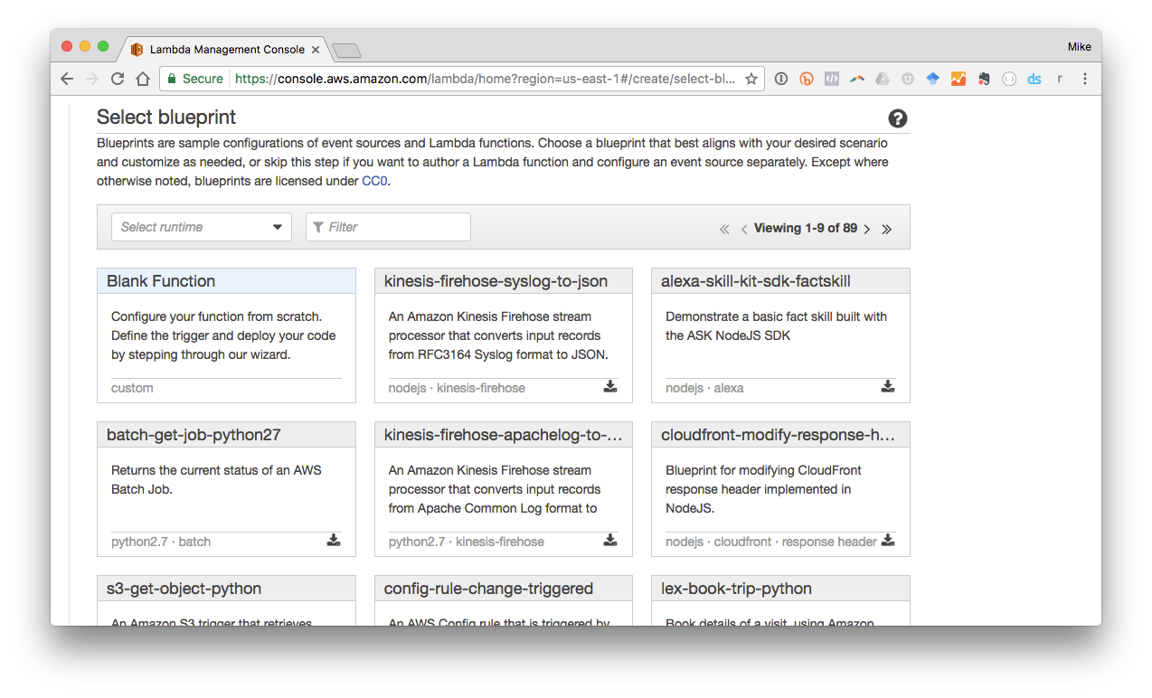
Select “alexa-skill-kit-sdk-factskill”
for this Example.
AWS has a bunch of awesome templates for you to start with. We’re going to edit an existing one.
Notes:
What to Say:
The folks at Amazon created a bunch of awesome templates for Lambda.
We are going to find the one called “alexa-skill-kit-sdk-factskill”
This is important because it includes some of the libraries we need.
If we started from scratch we would need to include those.
What to Do:
Ask participants to find and click on “alexa-skill-kit-sdk-factskill”
Walk around and make sure they are finding everything OK

Slide 29
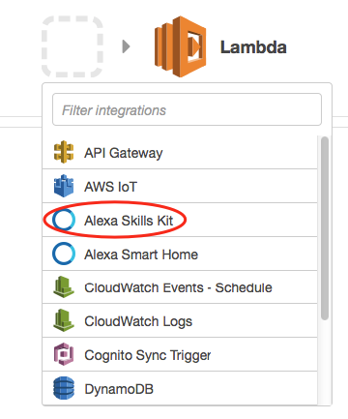
Configure your Trigger.
We need to setup a trigger to call our new Lambda Function (in our case Alexa Skills Kit).
Instructions
Click on the gray dash-lined box
Select “Alexa Skills Kit” from the dropdown menu
Click the Next button to continue.
Notes:
What to Say:
AWS Lambda Functions are triggered by events
In this case, we want our function to be triggered by the “Alexa Skills Kit” event
You may need to click on the gray box to get the menu to appear
What to Do:
Ask participants to find and click on “Alexa Skills Kit” trigger
Walk around and make sure they are finding everything OK

Slide 30
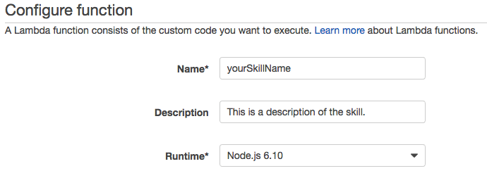
Configure your Lambda Function
Enter a Name, Description, and select "Node 6.1" as the Runtime for your skill as in the example.
Notes:
What to Say:
AWS Lambda Functions have some basic configuration options
Name is what your function is called
Description is a short sentence to help describe what the function does to you
Runtime is the programming environment the function uses. Leave this as the default (Node.js 6.10)
What to Do:
Ask participants to fill out the form and leave the default runtime (Node.js 6.10).
Walk around and make sure they are finding everything OK

Slide 31
Step 1: Download the Sample Code
Step 2: Open Index.js
To get the sample code, head to this URL:
mlhlocal.host/alexa-code
Unzip the directory and open src/index.js in your
favorite code editor.
Notes:
What to Say:
To create your skill, you’re going to be editing a sample MLH is providing you
The link is in your email as well since you checked in
Once everyone opens the file, we are going to walk through it together
What to Do:
Ask participants to:
Download the Zip file by following the link on the screen or their email
Unzip the file and open the directory called “src” inside it
Open index.js in their favorite code editor (they can download Atom or Sublime if they don’t have one)
Walk around and make sure everyone is able to open the file.

Slide 32
Customize your Facts
Find the FACTS array inside index.js. Replace the facts about MLH with some facts about yourself!
12 // TODO: replace with facts about yourself
13 const FACTS = [
14 "Major League Hacking is commonly called MLH.",
15 "Major League Hacking's mission is to empower hackers.",
16 "Over 65,000 student hackers participated in Major League Hacking...",
17 "Major League Hacking was founded in 2013 by Swift and Jon.",
18 "Hackers created over 12,000 projects at MLH hackathons in 2016.",
19 "Over 200 schools around the world hosted MLH hackathons in 2016.",
20 "Major League Hacking is headquartered in New York City."
21 ];
Notes:
What to Say:
The first section of this file contains a list of facts about MLH.
We store this in a variable called “FACTS”
We’re going to replace these with some facts about you!
What to Do:
Ask participants to replace the list of facts with facts about themselves. This should take about 5-10 minutes.
Remind them to wrap their facts in quotation marks (“EXAMPLE TEXT”)
Each line needs to end with a comma (“,”) except the last one
Walk around and make sure everyone is able to open the file.

Slide 33
Code Review: The Handlers Object
The handlers object tells Alexa how to handle various actions. GetFact is the main logic of our application.
23 var handlers = {
24 'LaunchRequest': function() { this.emit('GetFact'); },
25 'GetNewFactIntent': function() { this.emit('GetFact'); },
26 'GetFact': function() {
27 // Randomly select a fact from the array
28 const factIndex = Math.floor(Math.random() * FACTS.length);
29 const randomFact = FACTS[factIndex];
30
31 // Create speech output
32 const speechOutput = "Here's your fact: " + randomFact;
33 this.emit(':tellWithCard', speechOutput, "MLH Facts", randomFact);
34 }
35 };
Notes:
What to Say:
The next section maps intents (Launch and Get New Fact) to actual code.
Both “LaunchIntent” and “GetNewFactIntent” trigger the “GetFact” function.
The GetFact function does the following:
Select a random element from the FACTS list
Prepend “Here’s your fact” to the fact
Tell Alexa to respond with the fact by emitting a “:tellWithCard” event.
What to Do:
Walk participants through the code and make sure everyone understands.

Slide 34
Code Review: The Handler Function
The handler function tells Alexa how to route voice commands by passing a copy of the handlers object.
37 // AWS Lambda calls this function every time Alexa uses our skill.
38 exports.handler = function(event, context, callback) {
39 // Include the AWS Alexa Library.
40 const Alexa = require("alexa-sdk");
41
42 // Create an instance of the Alexa library & pass it the requested command.
43 var alexa = Alexa.handler(event, context);
44
45 // Give our Alexa instance handling instructions & execute the request.
46 alexa.registerHandlers(handlers);
47 alexa.execute();
48 };
Notes:
What to Say:
The final section passes our configuration to Alexa using the Alexa SDK
We instantiate a new Alexa object and pass it the parsed speech the user gave us
Register the list of handlers we created in the last section so Alexa knows how to respond.
Execute the request.
What to Do:
Walk participants through the code and make sure everyone understands.

Slide 35
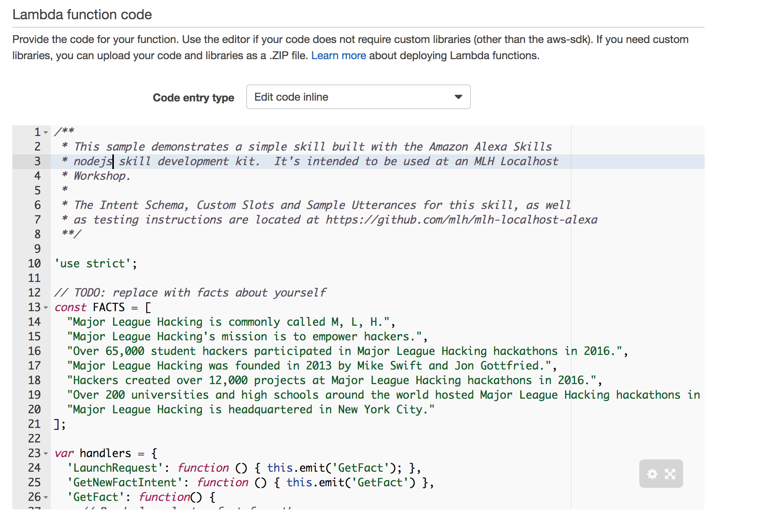
Copy & Paste your Code into the Lambda Editor
Copy the entire contents of index.js and paste it over the code in the inline editor on the AWS Console.
Notes:
What to Say:
Copy the full contents of the index.js file into the Lambda editor on the AWS website
Make sure you copy the full file and paste over the entire contents of what is already in the editor.
What to Do:
Explain how to copy and paste the contents, making sure to highlight the importance of completely overwriting the existing content on the Lambda Editor.
Walk around and make sure participants aren’t having trouble.

Slide 36
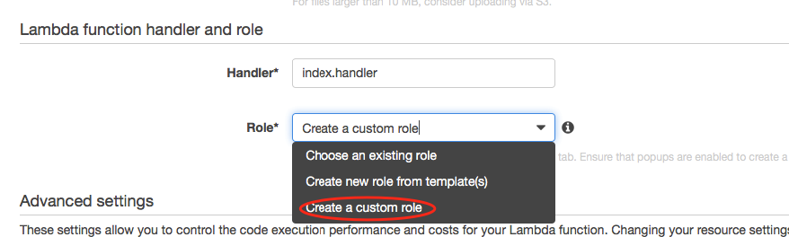
Set Lamba Handler & IAM Role
Leave the handler as index.handler & select
“Create a custom role” from the Role Dropdown menu.
Setting the role gives Alexa permission to execute
your AWS Lambda Function.
Notes:
What to Say:
Scrolling down to the next section, you will see some settings for a handler and role.
From the role drop down, select “Create a Custom Role”
This will open a new tab which we will cover in the next slide.
What to Do:
Walk around and make sure they are finding everything OK

Slide 37
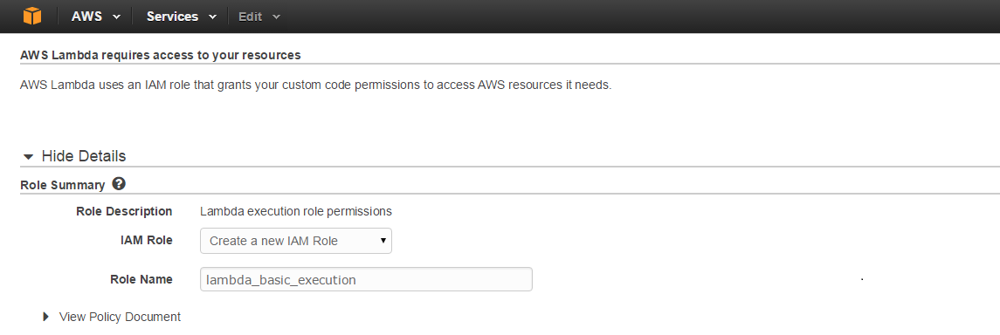
Create your IAM Role
Select "Create a new IAM Role" from dropdown menu. Role Name & policy will automatically populate.
Select “Allow” in the lower right corner and you will be returned to your Lambda function.
Notes:
What to Say:
IAM Roles tell Amazon which services should have access to which information.
We want to create a new role that enables our lambda function access to execute
What to Do:
Instruct participants to select "Create a new IAM Role" from dropdown menu.
Create the new role by clicking “Allow” in the bottom right corner
Walk around and make sure they are finding everything OK

Slide 38
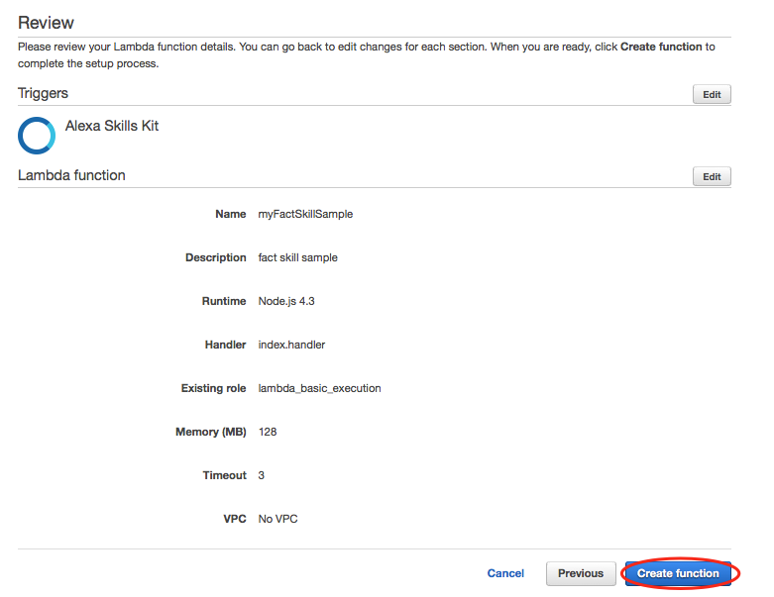
Finalize your AWS Lambda Function
Keep the default Advanced settings & select "Next". Confirm the details & click "Create Function".
Notes:
What to Say:
We can leave all the defaults for the advanced settings and tags
Hit “Next” and you should be presented with a confirmation page that looks something like this one.
What to Do:
Confirm that everyone is seeing the confirmation page by a show of hands
Walk around and make sure they are finding everything OK

Slide 39
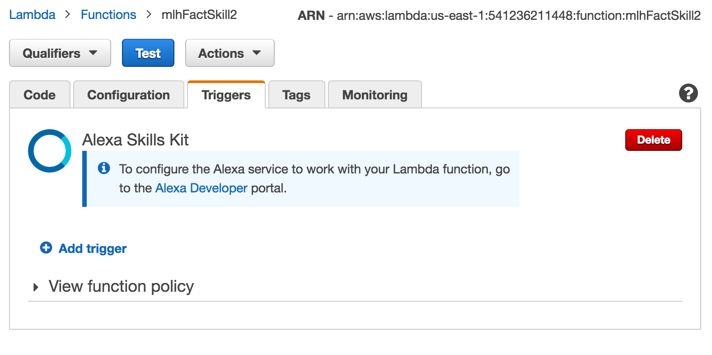
Test your AWS Lambda Function
To test that your Lambda function is working,
Just click the “test” button.
Notes:
What to Say:
That’s the basics of an Alexa skill. How do you know it’s working though?
The folks at Amazon created some tools to make it easy to test.
Everyone click the blue “Test” button as seen on this slide
What to Do:
Confirm that everyone is sees the “Test” button and clicks it

Slide 40
Test your AWS Lambda Function
To test that your Lambda function is working,
Just click the “test” button.
Notes:
What to Say:
That’s the basics of an Alexa skill. How do you know it’s working though?
The folks at Amazon created some tools to make it easy to test.
Everyone click the blue “Test” button as seen on this slide
What to Do:
Confirm that everyone is sees the “Test” button and clicks it

Slide 41
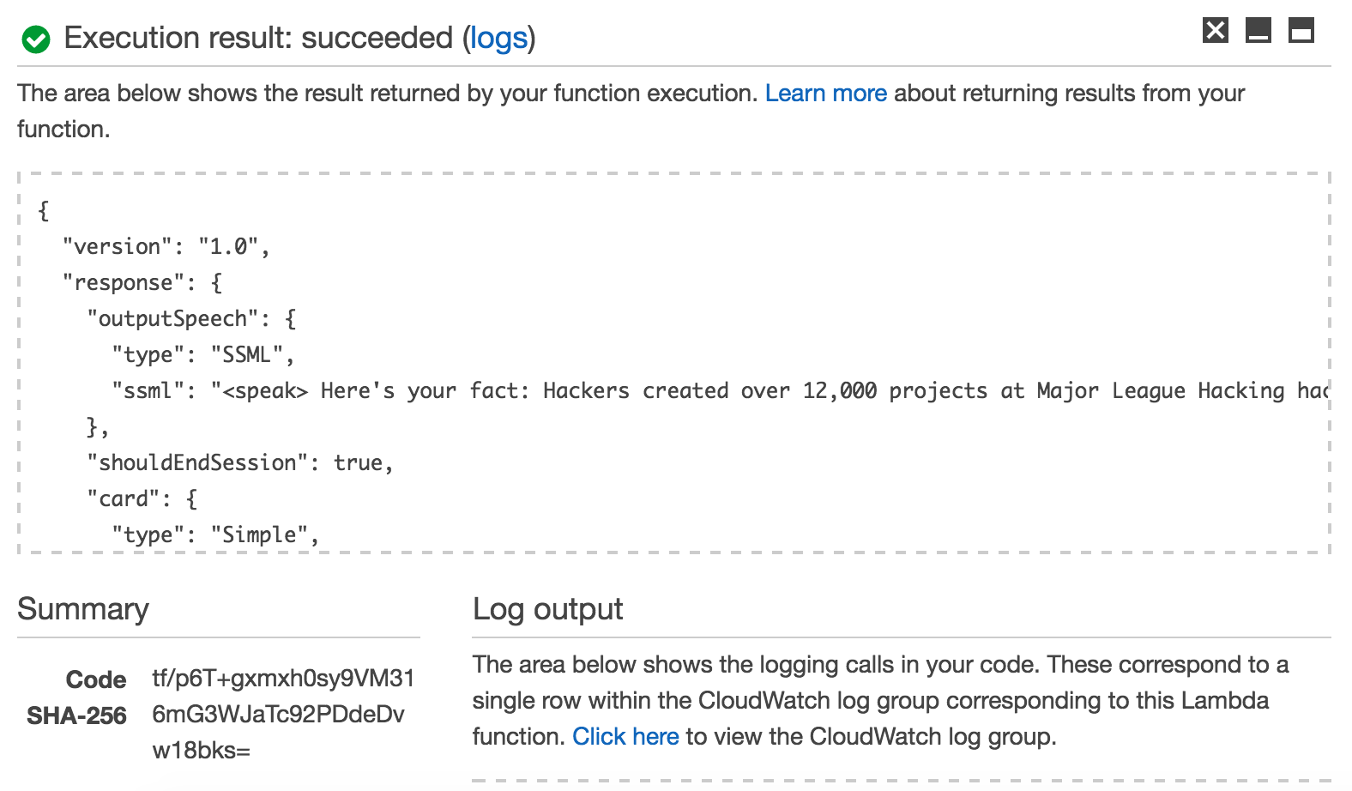
Test your AWS Lambda Function
If it’s working, you should see output
similar to the following:
Notes:
What to Say:
If you entered and configured everything correctly you should see a success message like this one
What to Do:
Confirm that everyone’s function executed successfully by a show of hands
Walk around and help the people who had trouble

Slide 42
Note Down your Function’s ARN.
You’ll need it in a few steps, so either keep this tab open or save it in a file somewhere now.
Notes:
What to Say:
We’ve completed the backend of your Alexa skill using AWS Lambda.
Next we’re going register our function as an actual skill that Alexa can use
Before we move on, note the “ARN” (Amazon Resource Name) at the top of your screen. This is basically a unique identifier for your Lambda function.
We’re going to need this to connect our Alexa skill in a few minutes, so keep this tab open or copy it into a file on your desktop.
What to Do:
Confirm that everyone’s found the ARN.
Remind everyone to keep this tab open or save the ARN so they can use it later.

Slide 43
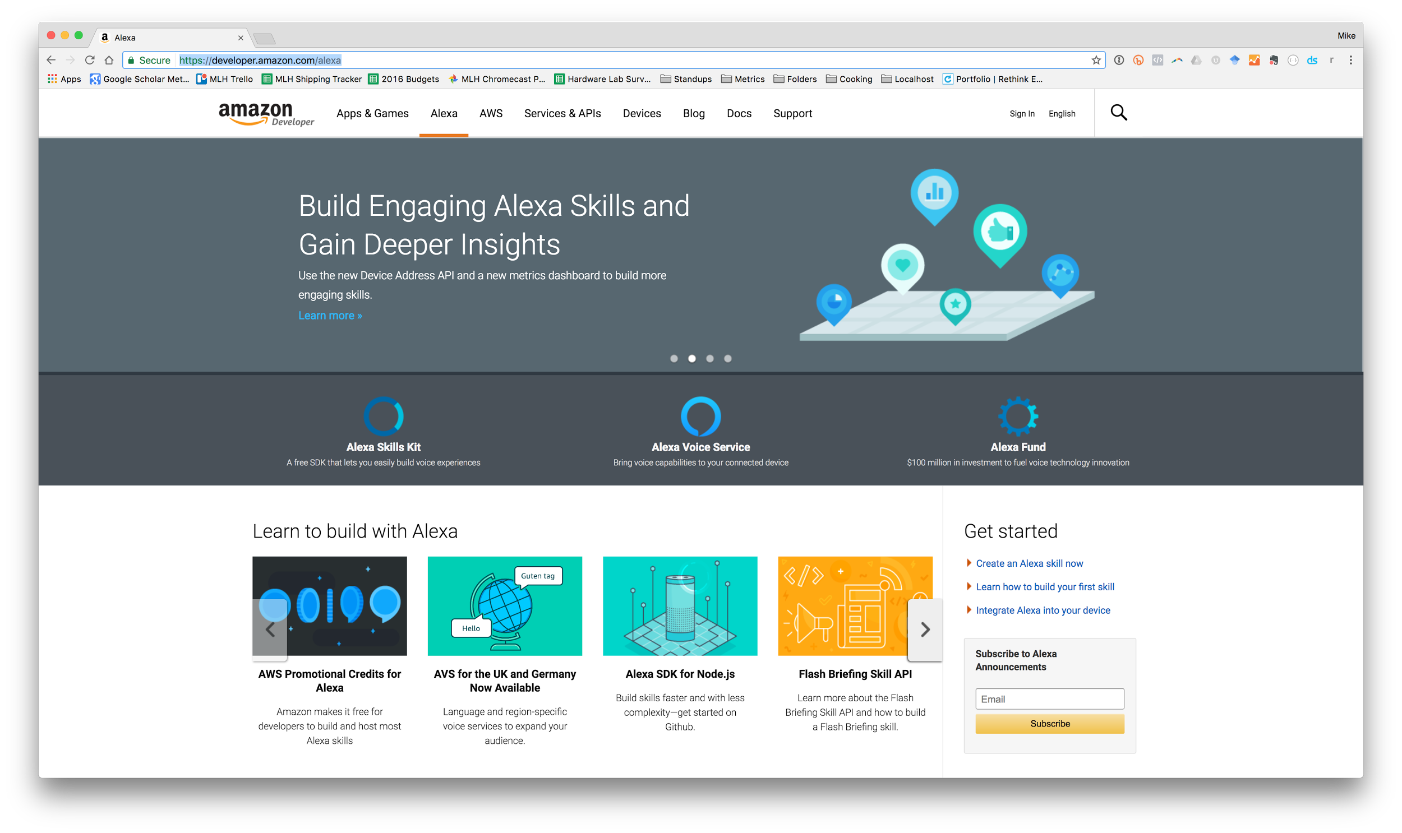
Sign into the Amazon Developer Portal.
Head over to:
mlhlocal.host/alexa-portal
Notes:
What to Say:
Alexa skills are managed through the Amazon developer portal (developer.amazon.com).
The URL on the screen is a shortcut to the Alexa specific content.
You’ll need to sign in using the Amazon account you used to create your Lambda function.
You may also need to register for a developer account.
What to Do:
Make sure everyone is able to sign in to the Amazon developer portal.
The next slide shows the profile creation step, so move on once you see that everyone is there.

Slide 44
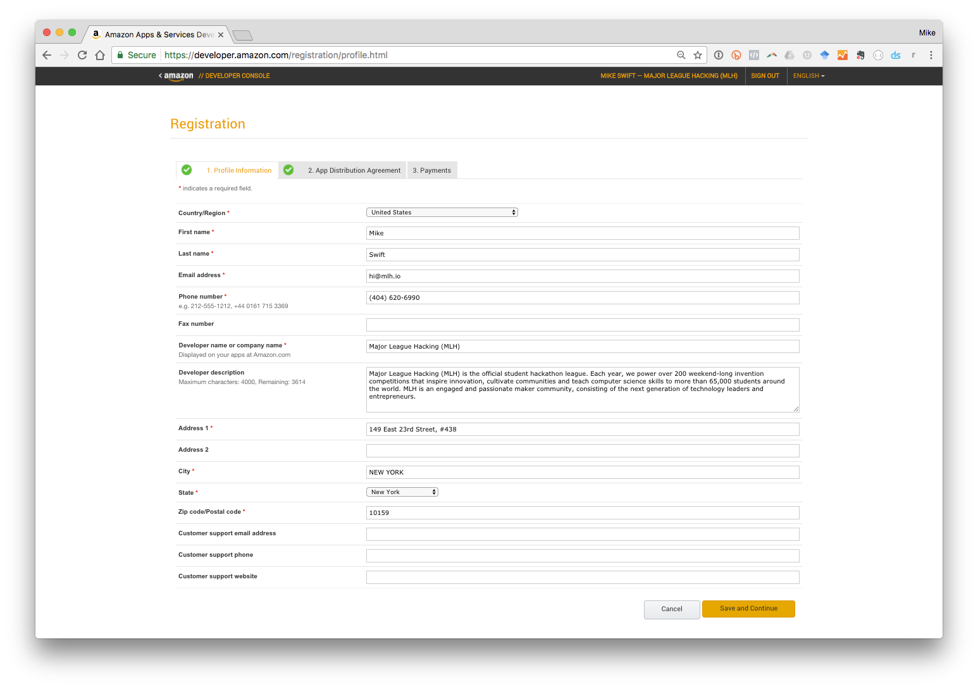
Create your Developer Profile
You’ll need to fill out the registration form
& agree to the terms of usage.
Notes:
What to Say:
To register for your developer account fill out this form and agree to the terms of usage.
What to Do:
Make sure everyone is able to sign in to the Amazon developer portal.

Slide 45
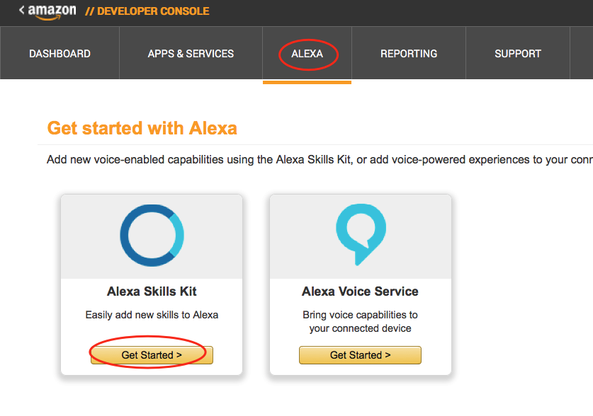
Create a New Alexa Skill
Navigate to the Alexa tab
Click on "Getting Started" under “Alexa Skills Kit”
Click “Add a New Skill” in the top right
#1
#2
Notes:
What to Say:
Now that you’ve signed in, navigate to the “Alexa” tab if you aren’t already there.
Find the “Alexa Skills Kit” card and click “Get Started” to register you first skill.
This will take you to a list of your Alexa skills. To create a new one, click “Add a New Skill” in the top right.
What to Do:
Make sure everyone is following along and not having any trouble.
NOTE: Amazon released a new version of the skill building interface. If participants are confused or you see that they have a different interface than you see on the slides, click the “Opt Out” link to go back to the original skill building interface.

Slide 46
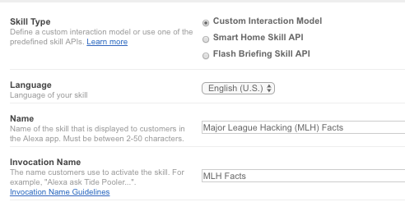
Name your Skill
Select “Custom Interaction Model” for Skill Type
Enter a Name for your Skill.
Enter an Invocation Name for your Skill.
Select the "No" option under Audio Player and click “Next”.
Notes:
What to Say:
Now it’s time to configure your skill.
Make sure you have “Customer Interaction Model” selected for skill type. There are a bunch of other types of Alexa skills, but this is the most common one.
Give your skill a name that other people would see on the Alexa App. This is probably your full name plus the word “facts”.
We’ll talk about invocation name on the next slide
What to Do:
Make sure everyone is following along and not having any trouble.

Slide 47
What is the Invocation Name?
Alexa, open MLH facts.
This is a 1-3 word phrase that users will say out loud to launch your skill.
Wake Word
Launch
Skill Invocation Name
Notes:
What to Say:
Users will say something with the following structure to Alexa:
Wake Word - this is the word which signals that Alexa should start listening.
Launch - this is the instruction for Alexa about what to do. Since this is a skill launch means open the corresponding application.
Skill Invocation name - the phrase that a user will utter to launch your skill.
What to Do:
Instruct everyone to select their Invocation Name, fill out the form, and hit save.
Make sure everyone is following along and not having any trouble.

Slide 48
Grab the Intent Schema JSON
There’s a file called SpeechAssets/IntentSchema.json inside the code you downloaded earlier with the following JSON:
01 {
02 "intents": [
03 { "intent": "GetNewFactIntent" },
04 { "intent": "AMAZON.HelpIntent" },
05 { "intent": "AMAZON.StopIntent" },
06 { "intent": "AMAZON.CancelIntent" }
07 ]
08 }
This code tells Alexa which code to trigger in our Lambda Function and some basic defaults like “STOP” and “HELP”.
Notes:
What to Say:
The Intent Schema is a bit of JSON which maps Alexa keywords to Lambda functions.
The JSON we’re going to use also includes some basic defaults like Stop, Help, and Cancel.
You can find this code in the zip file you downloaded earlier under the “SpeechAssets” directory.
What to Do:
Ask everyone to open the IntentSchema.json file and copy the code into their clipboard.
Make sure everyone is following along and not having any trouble.

Slide 49
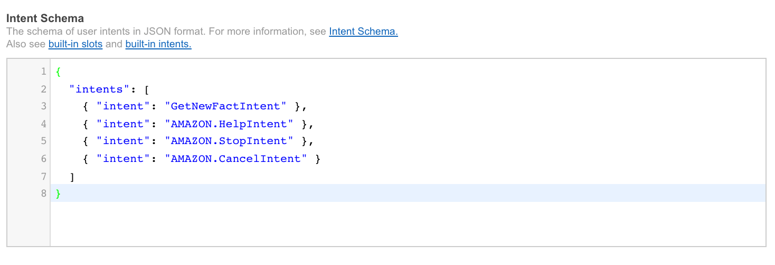
Paste the JSON into the Intent Schema Box
Copy the code you found in SpeechAssets/IntentSchema.json into the box on the Alexa Developer dashboard.
Notes:
What to Say:
Now paste the code from IntentSchema.json into the corresponding section of your web browser.
What to Do:
Make sure everyone is following along and not having any trouble.

Slide 50
Customize your Utterances
Open up SpeechAssets/SampleUtterances.txt and replace “Major League Hacking” with your name:
01 GetNewFactIntent a fact
02 GetNewFactIntent a Major League Hacking fact
03 GetNewFactIntent tell me a fact
04 GetNewFactIntent tell me a Major League Hacking fact
05 GetNewFactIntent give me a fact
06 GetNewFactIntent give me a Major League Hacking fact
07 GetNewFactIntent tell me trivia
08 GetNewFactIntent tell me a Major League Hacking trivia
09 GetNewFactIntent give me trivia
10 GetNewFactIntent give me a Major League Hacking trivia
11 GetNewFactIntent give me some information
12 GetNewFactIntent give me some Major League Hacking information
13 GetNewFactIntent tell me something
14 GetNewFactIntent give me something
Notes:
What to Say:
The next thing we need to configure is the set of Sample Utterances.
This is not meant to be an exhaustive list, but should be a set of basic examples of how you want users to interact with your skill.
You can find these inside the SpeechAssets folder of the zip file you downloaded earlier.
What to Do:
Ask everyone to open the SampleUtterances.txt file and replace the relevant bits with their Invocation Name
Once they have updated the sample utterances, ask participants to copy the values into their clipboards.
Make sure everyone is following along and not having any trouble.

Slide 51
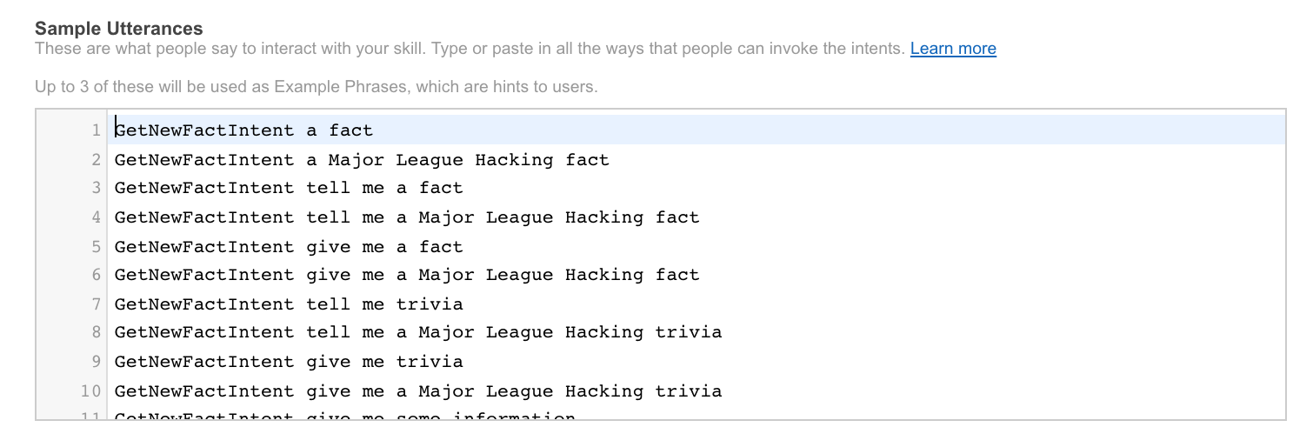
Paste your Custom Utterances into the Sample Utterances Box
Copy your customized SpeechAssets/SampleUtterances.txt into the box on the Alexa Developer dashboard.
Notes:
What to Say:
Now paste the code from SampleUtterances.txt into the corresponding section of your web browser.
What to Do:
Make sure everyone is following along and not having any trouble.

Slide 52
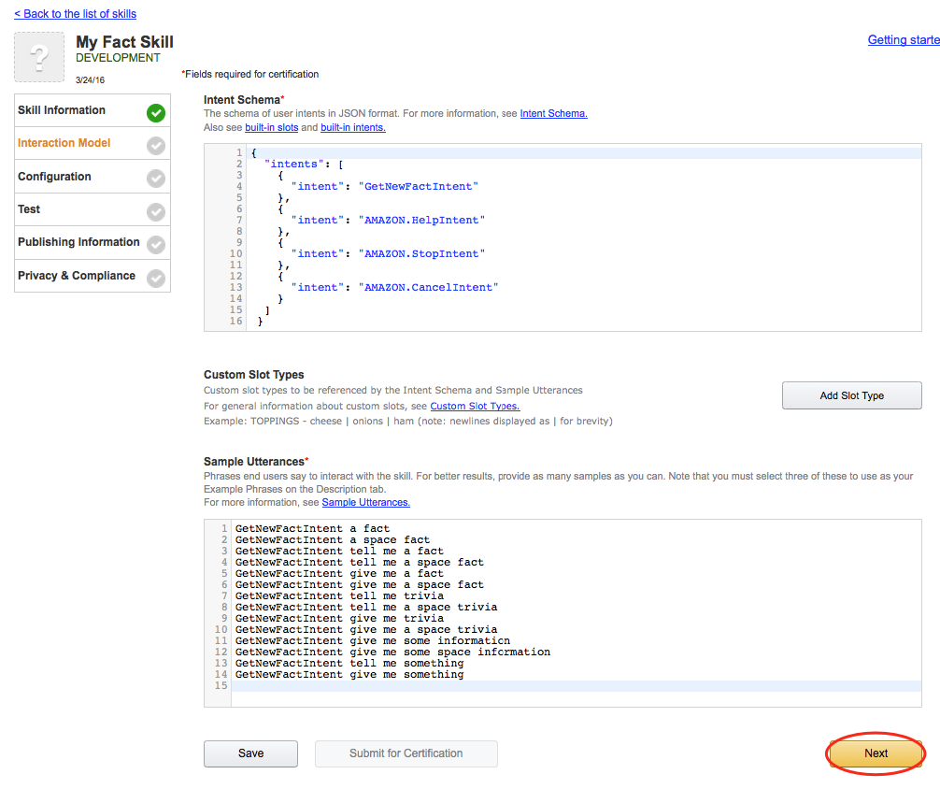
Save your Interaction Model and Continue.
Once you’ve defined your intent schema & sample utterances,
hit “next” in the bottom corner to move on.
Notes:
What to Say:
Make sure that you have the correct sections filled out. They should be “Intent Schema” and “Sample Utterances”. Everything else is optional.
Click “next” in the bottom right to move on to the next step.
What to Do:
Make sure everyone is following along and not having any trouble.

Slide 53
Go get your Lambda Function’s ARN
Remember the ARN we noted down earlier?
Time to put it to use, go grab it now!
Notes:
What to Say:
In the next section we need that ARN from the Lambda function we made earlier.
What to Do:
Instruct participants to switch back to the tab they were using earlier and copy the ARN. This should be everything after the dash.
If someone closed the tab, send them back to aws.amazon.com and reopen the lambda function they created.
Make sure everyone is following along and not having any trouble.

Slide 54
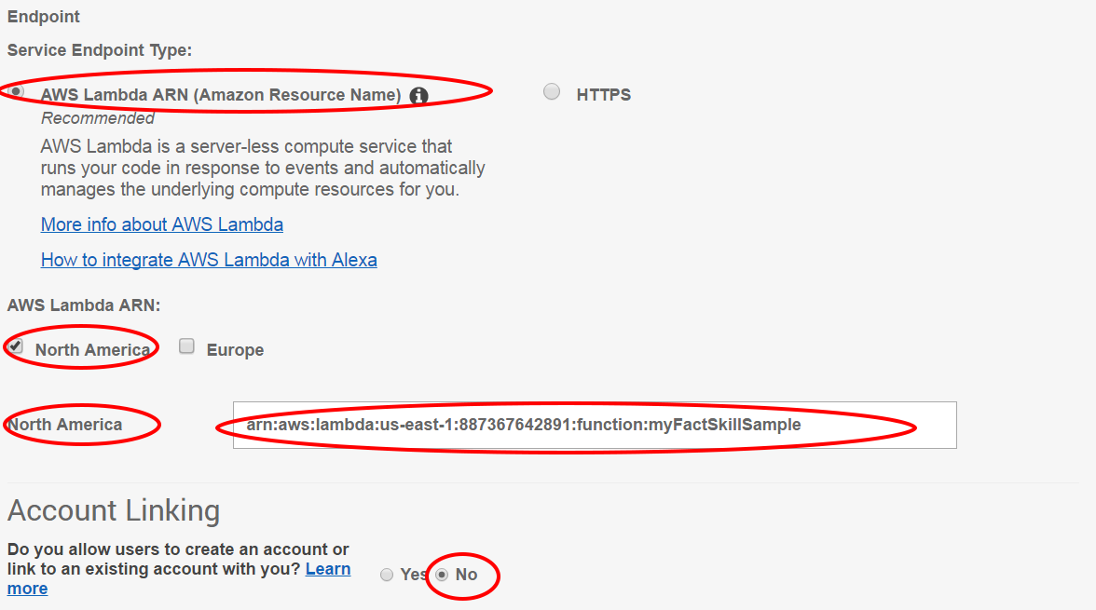
Connect Your Lambda Function to Your Skill.
Select AWS Lambda ARN and the Region closest to you. Paste the ARN from your function in the text box.
Notes:
What to Say:
Now we’re going to link your Alexa skill to the Lambda backend we made earlier.
Select “AWS Lambda ARN (Amazon Resource Name)” as the endpoint type and “North America” as your region (yes, even you EU folks for now).
Paste the ARN you just copied into the box that appears below.
Make sure that “account linking” is off and that everything else is unchecked.
Finally, hit “Next” to continue.
What to Do:
Instruct participants to paste the ARN they copied into the text box.
Alexa only works in the US East 1 (North Virginia) region right now, so leave the region alone unless you know what you are doing.
Make sure everyone is following along and not having any trouble.

Slide 55
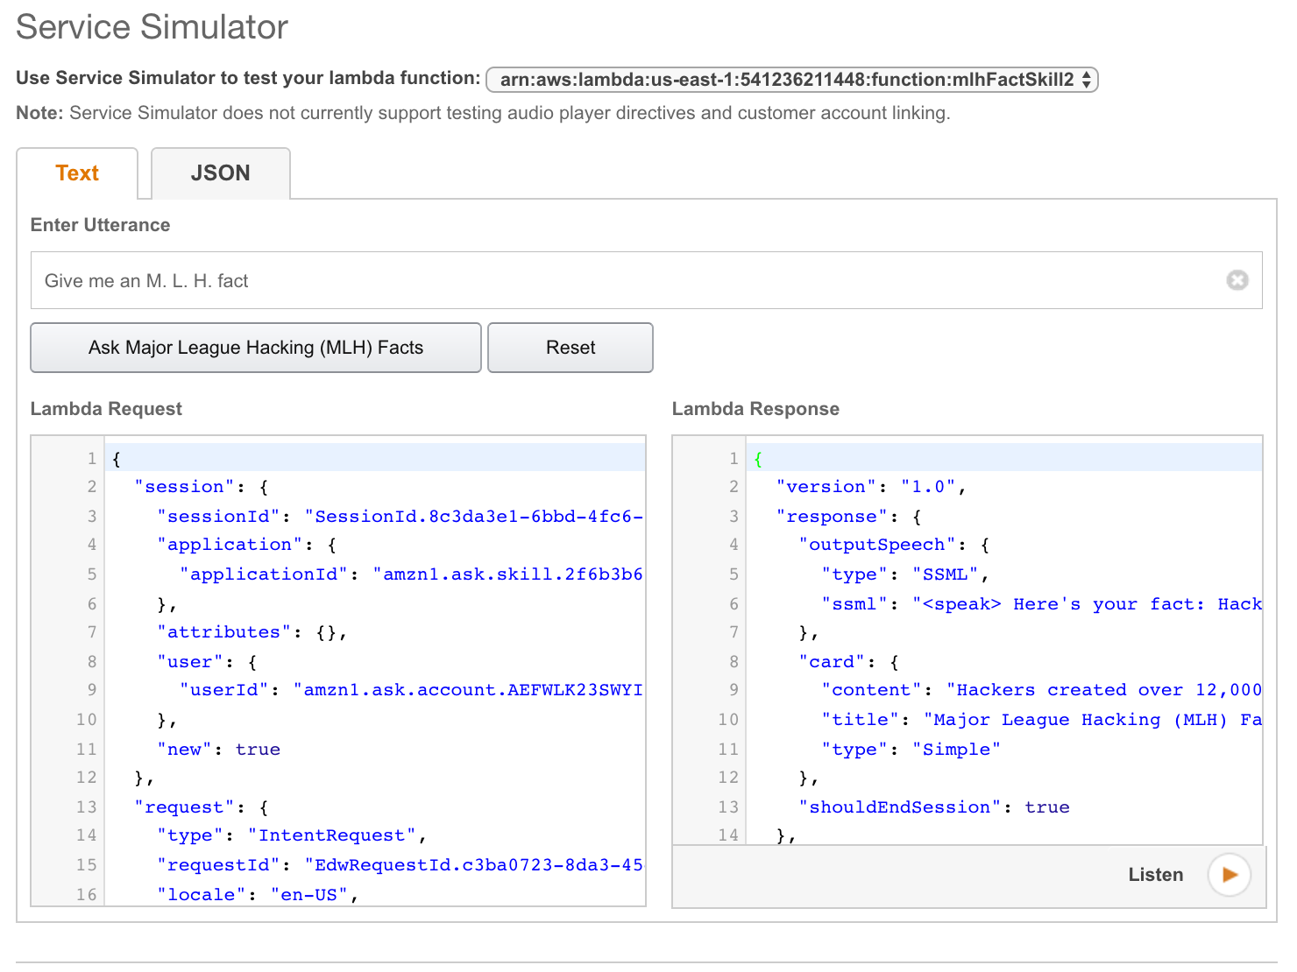
Test your Skill
Type one of your sample utterances into the service
simulator to see how Alexa would respond.
Hear what Alexa would say by clicking “Listen”.
Notes:
What to Say:
If you entered all of the information correctly, you should be able to test you skill on the next page.
You can type what you would expect the user to say into the textbox under the “Service Simulator” section.
Try entering something like “Alexa open [YOUR INVOCATION NAME]” to see if you get a response.
What to Do:
Demonstrate testing your skill by entering “Alexa open [YOUR INVOCATION NAME]” into the text box and clicking the “Ask” button”. You can play the response by clicking “Listen” on the bottom right of the response.
Make sure everyone is following along and not having any trouble.

Slide 56
Try out Your Skill!
Head to EchoSim.io to try out your fact.
“Alexa, open [Your Invocation Name].”
If you want to try your skill on an Alexa Device, pair it with your account first!
Notes:
What to Say:
If you are able to test your skill on the console, you should be able to test it on an actual Alexa device or the simulator.
If you don’t have an echo device with you, log into “EchoSim.io” and try it there.
Make sure the account your Alexa is connected to is the account which you created the skill using.
What to Do:
Help participants test their skills on the simulator or an Alexa device if you have one.

Slide 57
Troubleshooting Your Skill
If you aren't getting a valid response, check the following:
Do you have the right ARN copied from your Developer Portal/Skill into your your Lambda function?
Are you calling the right invocation name?
Are you saying launch, start or open?
Are you sure you have no other skills in your accounts with the same invocation name?
Notes:
What to Say:
If you’re having trouble, here are some common issues that people encounter when making their first Alexa skill.
What to Do:
Walk around and make sure that everyone is able to successfully test their skill.

Slide 58
Notes:
What to Say:
Congratulations! You’ve successfully created your first Voice powered application using Amazon Alexa
Let’s do a quick recap of what we learned today by taking a fun quiz
Once we’re done, we’ll share some additional resources for you and get you started with next steps.

Slide 59

Let’s recap quickly...
1
Voice User Interfaces allow us to physically separate ourselves from devices.
2
Amazon Alexa makes it easy for you to create apps (skills) that utilize Voice User Interfaces.
3
Alexa takes care of speech recognition and context so you can focus on making a great app.
Notes:
What to Say:
Here’s a quick summary of the main points we covered
Voice User Interfaces are a new type of interface that allow us to physically separate ourselves from devices.
Amazon Alexa makes it easy for you to create apps (called skills) that utilize Voice User Interfaces to do things.
Amazon Alexa takes care of hard stuff like speech recognition and context so you can focus on making a great app.
What to Do:
Summarize the workshop learnings and recap what participants accomplished over the last hour or so.

Slide 60
What did you learn today?
We created a fun quiz to test your knowledge and see what you learned from this workshop.
http://mlhlocal.host/quiz
Notes:
What to Say:
Ok. It’s time to see what you learned today. Open up the following URL in your browser to complete the quiz and a short survey about this workshop
Once you finish, raise your hand and let me know what your score was!
What to Do:
Walk around and make sure participants are able to take the quiz.
Make sure everyone completes the quiz and survey. We use this information to improve the workshop for future hackers!

Slide 61
Notes:
What to Say:
So, where do you go from here?
We’ve got a bunch of great resources to help you keep learning about Amazon Alexa
We also have some challenges if you want to keep iterating on your skill

Slide 62

Get credit & freebies from Amazon!
http://mlhlocal.host/alexa-promo
Our friends at Amazon Web Services run promotions in certain areas to reward hackers for making skills for the Amazon Alexa Platform.
Fill this out to get credit!
Notes:
What to Say:
Our friends at Amazon Web Services run promotions in certain areas to reward hackers for making skills for the Amazon Alexa Platform.
This could be anything from a t-shirt to a free Alexa device!
You’ll get an email from their team with details around what promotions apply to you.
You just learned how to make a skill, so why not get credit for it?
What to Do:
Instruct participants to head to the Alexa promo URL.

Slide 63
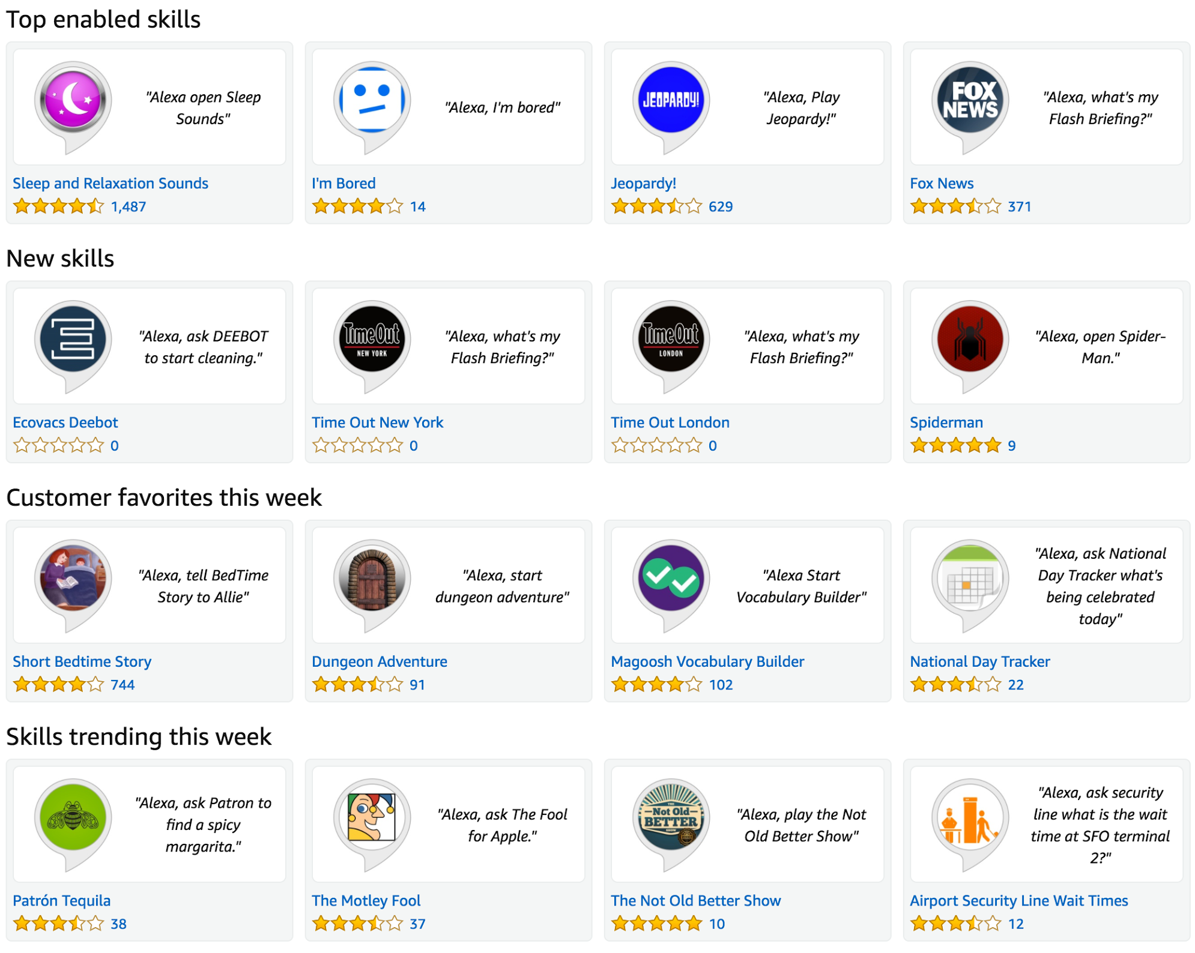
Next Steps: Publish your Skill!
You have a working skill, the next step is to publish it on the Alexa Skill Marketplace.
Instructions
Complete the “Publishing Information” and “Privacy and Compliance” sections on the developer portal.
Ensure that your skill meets the basic requirements.
Notes:
What to Say:
The most obvious next step is to actually publish your skill
You have a fully working skill that you could make available to Amazon Alexa devices everywhere
How cool will it be to show your friends your working skill?
This is also a great thing to add to your resumes.
What to Do:
Encourage participants to submit their skill before they head home for the day.
Give the overview of this challenge and move on to the next slide. The full details will be in participants emails.

Slide 64

Next Steps: Use Slots to Customize Further
Slots enable you to pass additional data to your Lambda function. Use slots to return a fact in a specific category (Ex. “facts about my education”).
Instructions
Read up about Slots and how to use them to pass data to your function.
Categorize your facts into a handful of groups.
Customize your function to return a fact based on the user specified category
Notes:
What to Say:
If you’re looking for something a little more challenging, why not try customizing your skill with Slots?
Slots enable you to pass additional data to your Lambda function
Try customizing your skill to return a fact from a specific category by using slots.
What to Do:
Give the overview of this challenge and move on to the next slide. The full details will be in participants emails.

Slide 65

Learning shouldn’t stop when the workshop ends...
Check your email for access to:
These workshop slides
Practice problems to keep learning
Deeper dives into key topics
Instructions to join the community
More opportunities from MLH!
Notes:
What to Say:
Just because this workshop is about to end doesn’t mean that the learning should too.
Check your email for lots of additional resources to help you keep building with Amazon Alexa
If you got stuck or need any help, join us on slack in the #amazon-alexa channel.
What to Do:
Thank everyone for coming
Answer any outstanding questions
Encourage everyone to publish their skill

Slide 66
v.0.0.1

